Slide 1

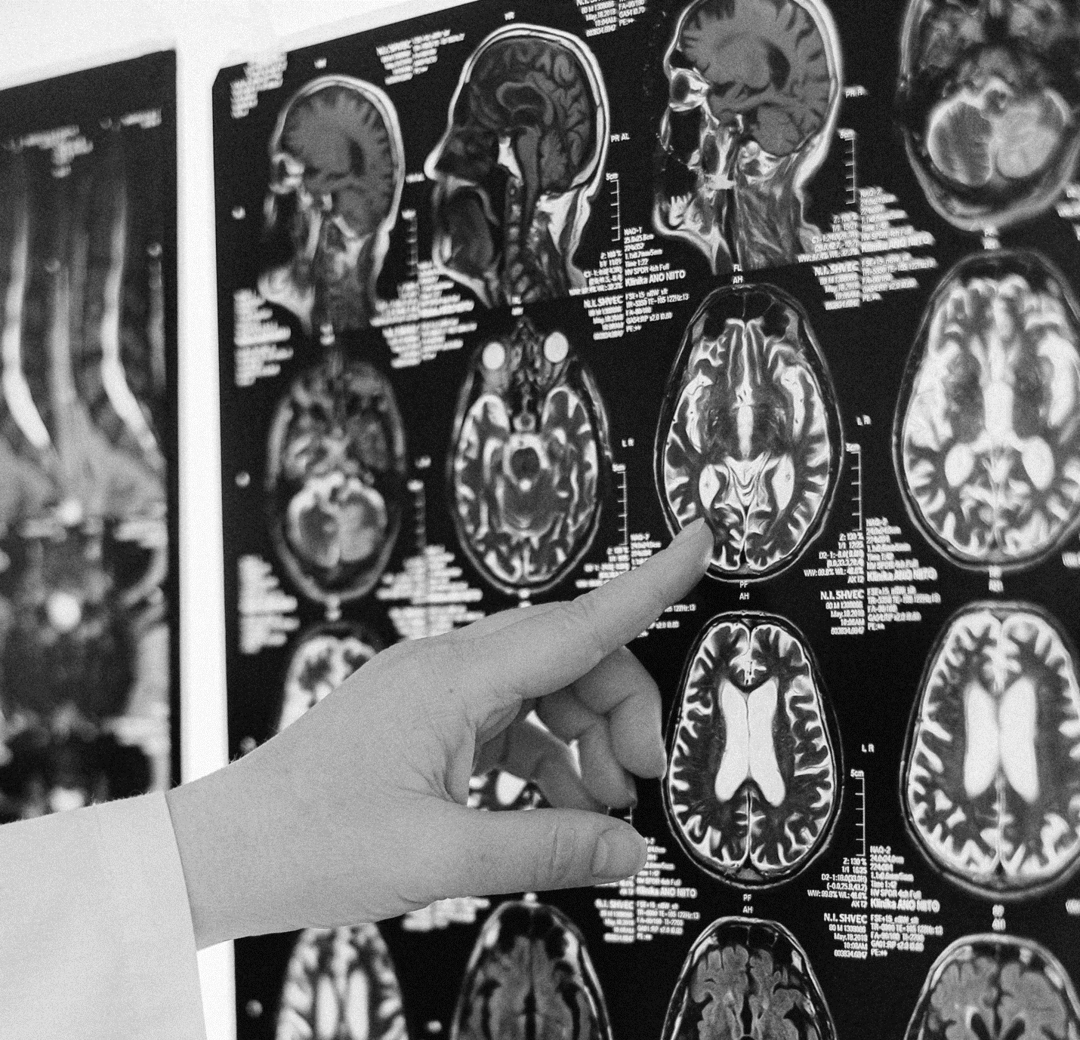
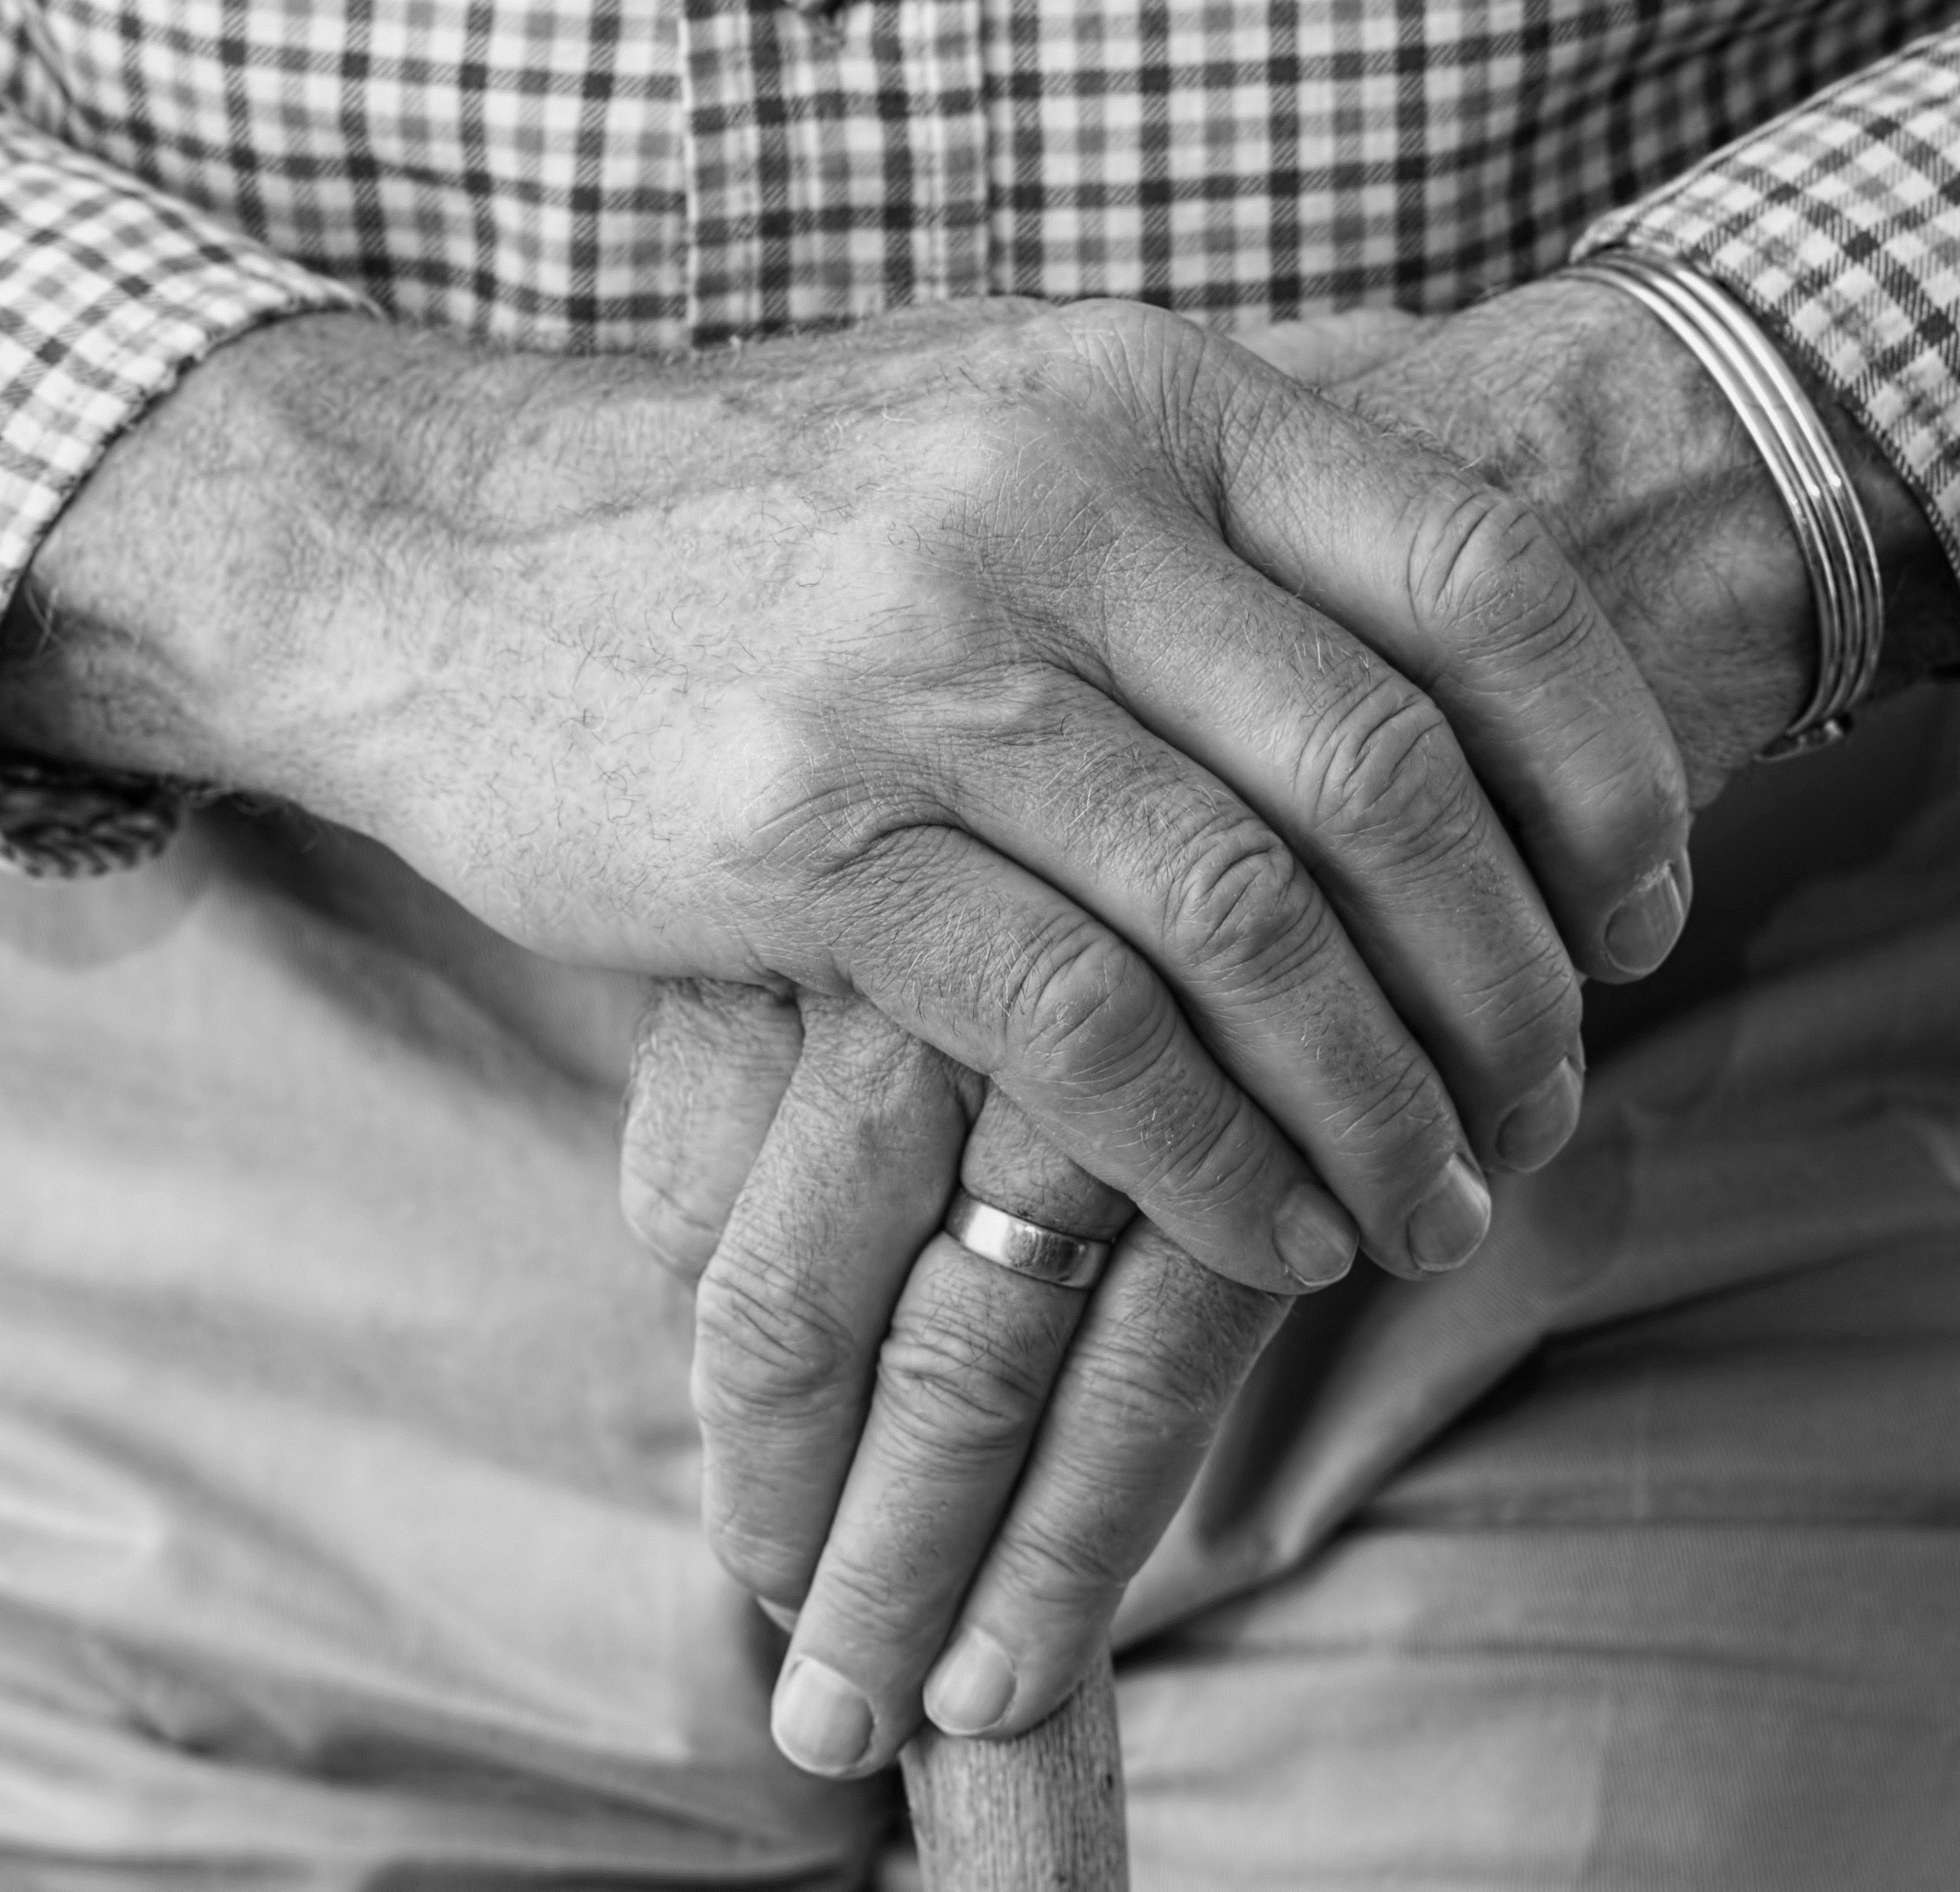


Final Year Project Viva
Classification of Cognitive Frailty in Elderly People from Blood Samples using Machine Learning
Shahidan bin Idris (25204)
Electrical & Electronics Engineering
MAY 2021
Supervised by : Associate Professor Dr Nasreen binti Badruddin
External Examiner : Ir Dr Shawn Tan
Internal Examiner : Associate Professor Dr Vijanth Sagayan a/l Asirvadam

Slide 2
Table of Contents
Introduction | 1
Literature Review | 11
Methodology | 12
Results & Discussion | 21
Conclusion | 47
References | 48

Slide 3
1
Source: Department of Statistics – Population by age group, sex and ethnic group, 2010 – 2019(estimated), Malaysia
The increase in the aging population is accompanied by the increase in age-related diseases
Introduction | Literature Review | Methodology | Results & Discussion | Conclusion | References

Slide 4
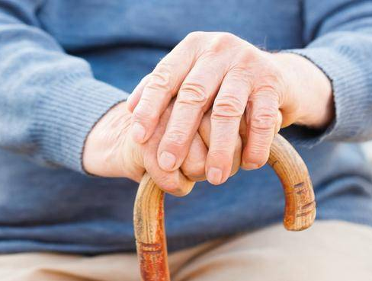

2
Physical Frailty
Mild Cognitive Impairment (MCI)
Introduction | Literature Review | Methodology | Results & Discussion | Conclusion | References

Slide 5
3
Physical Frailty
Weakness, slowness, low level of physical activity, exhaustion and poor endurance, and weight loss [1]
Introduction | Literature Review | Methodology | Results & Discussion | Conclusion | References

Slide 6
4
Mild Cognitive Impairment (MCI)
A condition characterised as cognitive decline that is greater than normal for an individual's age and education level but does not significantly interfere with everyday activities. [2]
Introduction | Literature Review | Methodology | Results & Discussion | Conclusion | References

Slide 7
5
Physical Frailty
Mild Cognitive Impairment (MCI)
Introduction | Literature Review | Methodology | Results & Discussion | Conclusion | References

Slide 8
5
Cognitive Frailty
“A syndrome in older adults with evidence of both physical frailty and cognitive impairment without a clinical diagnosis of Alzheimer’s Disease (AD) or another dementia.” [3]
Introduction | Literature Review | Methodology | Results & Discussion | Conclusion | References

Slide 9




6
Impacts of Cognitive Frailty
Older adults with Cognitive Frailty (CF) group have significant instrumental activities of daily living (IADL) limitations, such as [4]:
Using a bus or train
Grocery Shopping
Management of Finances
Housekeeping
Introduction | Literature Review | Methodology | Results & Discussion | Conclusion | References

Slide 10
7
Some numbers regarding Cognitive Frailty
For older adults with cognitive impairment, absolute mortality rate is [5]
The prevalence of Cognitive Frailty among older adults in Malaysia is [6]
70%
45%
34%
37.4%
2.2%
Frail
Pre-Frail
Non-Frail
Cognitive Pre-Frail
Cognitive Frail
Introduction | Literature Review | Methodology | Results & Discussion | Conclusion | References

Slide 11
8
Screening Tools & Measurements for Cognitive Frailty (CF)
1. Cognitive assessment
Montreal Cognitive assessment test (MoCa)
Mini Mental state Examination (MMsE)
2. Physical assessment
Measurement of gait speed, hand grip strength and weight loss (Fried Frailty Measurement)
FP Criteria | Measurement
Weakness | Grip Strength: lowest 20% (by sex, body mass index)
Slowness | Walking time/15 ft: slowest 20% (by sex, height)
Low Level of Physical Activity | Kcal/week: lowest 20% Male: 383 Kcal/week Female: 270 Kcal/week
Exhaustion, poor endurance | Self-reported exhaustion
Weight loss | >10 lb lost unintentionally in prior year
Introduction | Literature Review | Methodology | Results & Discussion | Conclusion | References

Slide 12
9
The Weakness of the Current Assessment Tools
Time Taken to Administer
Fried Frailty Measurement – 15 to 20 minutes [7]
MoCa or MMSE – 12 minutes
2. Function of these Tools
Measure symptoms related to CF
Identify the syndrome during its onset, rather than its early or pre-symptomatic stages
We need a tool for early and rapid identification of CF and its symptoms, before the syndrome manifests in a patient
Introduction | Literature Review | Methodology | Results & Discussion | Conclusion | References

Slide 13
10
Problem Statement
There is no existing classification model to predict Cognitive Frailty in elderly people using blood samples
Existing models classify Cognitive Frailty based on questionnaire responses and physical/cognitive assessment results, rather than biological parameters (e.g. blood parameters)
Models predicting the condition using biological parameters have been focused on physical frailty and mild cognitive impairment (MCI) separately
Attempts made have mostly conducted clustering (instead of classification) or used statistical analysis techniques rather than modern classification algorithms
Research Objectives
To develop a model to classify different levels of Cognitive Frailty in elderly people using blood sample parameters
To identify the top features/parameters from blood samples that indicate Cognitive Frailty in elderly people
To evaluate the effectiveness of the model in terms of accuracy, precision, and F1 score
Introduction | Literature Review | Methodology | Results & Discussion | Conclusion | References

Slide 14
11
Clustering Analysis on Frailty [8]
Classification & Prediction of Alzheimer’s Disease [10]
A total of 3 Clusters were formed
Cluster 2 – Highest non-frail patients
Cluster 3 – Highest pre-frail patients
Does not clearly identify or predict the disease through the variables used
Clustering Analysis – Significance Analysis of Microarrays (SAM)
Classification Algorithm – Predictive Analysis of Microarrays (PAM)
PAM achieved 90% positive agreement and 88% negative agreement
Statistical learning approaches were employed instead of modern machine learning algorithms
Predictive Model for Frailty [9]
Data from the Toledo Study for Healthy Aging (TSHA) – questionnaire answers, blood parameters, and vitals parameters
SVM – 78.31% ± 0.70% accuracy
Random Forest – 77.46% ± 0.45% accuracy
Top features came from questionnaire answers (closely related to assessment tools), not biological parameters
Overall, there is a lack of research conducted on Cognitive Frailty as a single complex phenotype
Introduction | Literature Review | Methodology | Results & Discussion | Conclusion | References

Slide 15
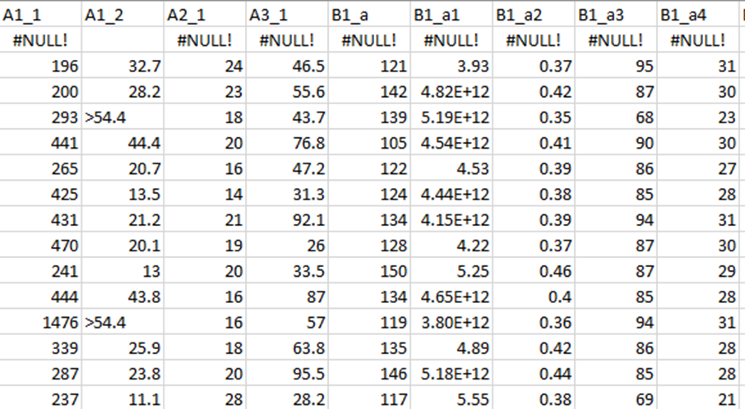
12
Dataset
Data Pre-processing
Input Optimisation
Performance Evaluation
Classification
Validation
Feature Selection
Data Sample
Name | Malaysian Elders Longitudinal Research (MELoR) dataset [8]
Data Format | String and Numerical
Data Details | 1123 rows, 59 columns 57 columns – Measurements of Blood-based Parameters (e.g. Glucose, Serum Folate, HbA1c) 1 column – Patient ID 1 column – Class Label (e.g. Robust, Frail Only, Frail with MCI)
Introduction | Literature Review | Methodology | Results & Discussion | Conclusion | References

Slide 16
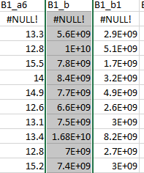
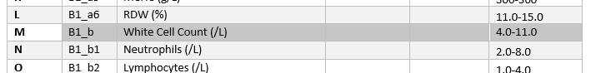
13
Dataset
Data Pre-processing
Input Optimisation
Performance Evaluation
Classification
Validation
Feature Selection
Dataset Values
1) Data Cleaning
Handle correctable errors in data entry (uniformly scaled)
Approach: Manual correction by referring to Data Dictionary
Data Dictionary
Introduction | Literature Review | Methodology | Results & Discussion | Conclusion | References

Slide 17
14
Dataset
Data Pre-processing
Input Optimisation
Performance Evaluation
Classification
Validation
Feature Selection
2) Data Deletion
Remove columns that do not have consistent scaling and have mismatched data types
Missing Value Ratio
Threshold 20%
Listwise Case Deletion
Remove any remaining rows that have NULL values in any of its values
Final Dataset Size:
1015 rows, 47 columns
Introduction | Literature Review | Methodology | Results & Discussion | Conclusion | References

Slide 18
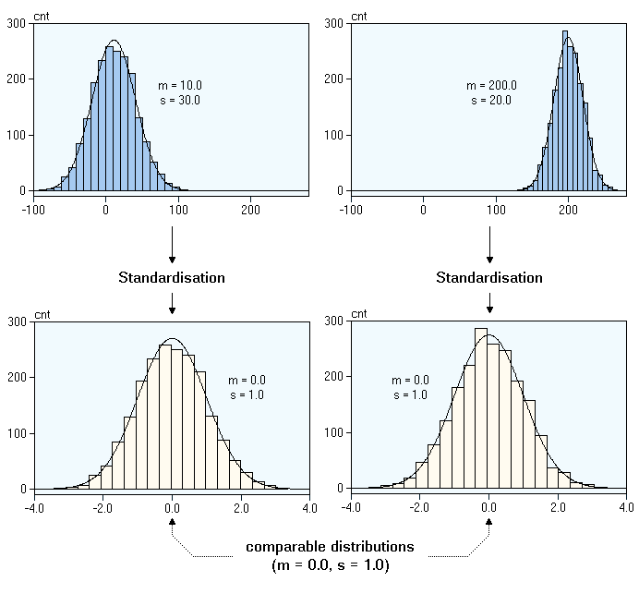
15
Dataset
Data Pre-processing
Input Optimisation
Performance Evaluation
Classification
Validation
Feature Selection
Data Standardisation & Normalisation
Standard/Min-Max Scaling
Encode Categorical Data (e.g. Labels)
Label-mapping technique
Introduction | Literature Review | Methodology | Results & Discussion | Conclusion | References

Slide 19
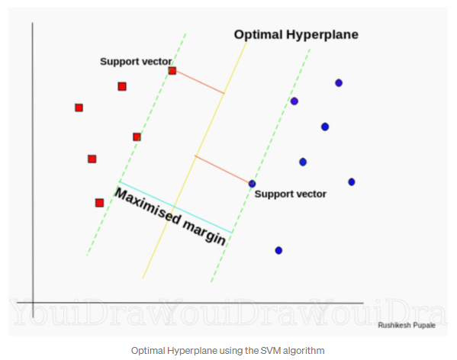
16
Dataset
Data Pre-processing
Input Optimisation
Performance Evaluation
Classification
Validation
Feature Selection
Classification Algorithms
Logistic Regression (LOG)
Linear Discriminant Analysis (LDA)
K-Nearest Neighbor (kNN)
Classification & Regression Tree (CART)
Gaussian Naïve Bayes (GNB)
Support Vector Machines (SVM)
Random Forest Classifier (RFC)
Introduction | Literature Review | Methodology | Results & Discussion | Conclusion | References

Slide 20
17
Dataset
Data Pre-processing
Input Optimisation
Performance Evaluation
Classification
Validation
Feature Selection
3 Classification Groups
iii) Robust vs Frail with MCI (taking the extreme ends of the spectrum)
Randomly undersample majority class to 76 samples (match minority class)
Oversample minority class to 343 samples (using SMOTE)
Undersample majority class to 76 samples, then SMOTE both classes to 100 samples
i) 6 Levels of CF:
Robust
Pre-Frail Only
Frail Only
MCI Only
Pre-Frail with MCI
Frail with MCI
ii) Robust vs Non-Robust (grouping the 5 remaining classes together)
Majority class (Non-Robust) is randomly undersampled to 343 Rows to match minority class (Robust)
Introduction | Literature Review | Methodology | Results & Discussion | Conclusion | References

Slide 21
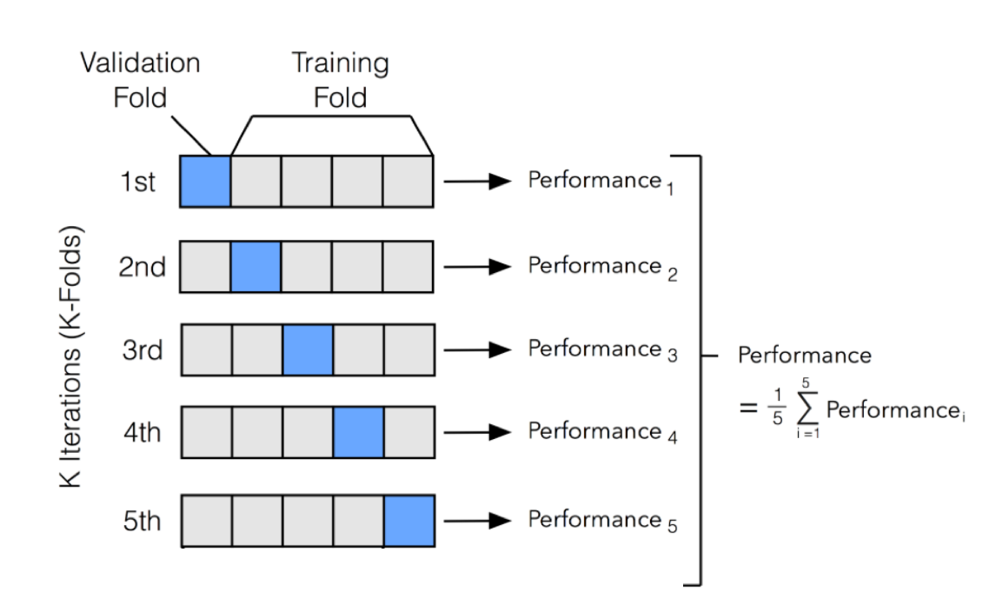
18
Dataset
Data Pre-processing
Input Optimisation
Performance Evaluation
Classification
Validation
Feature Selection
Validation Approach
Holdout Method (splitting dataset into training and test set)
60/40 for Train/Test
K-Fold Cross Validation
5-fold CV
Introduction | Literature Review | Methodology | Results & Discussion | Conclusion | References

Slide 22
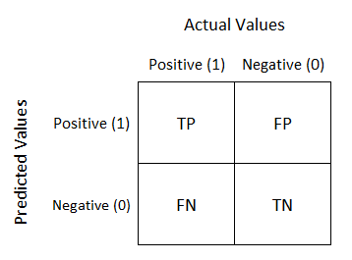
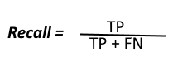
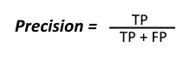
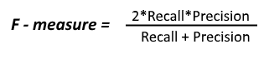
19
Dataset
Data Pre-processing
Input Optimisation
Performance Evaluation
Classification
Validation
Feature Selection
Evaluation Score Components
Accuracy Score
Confusion Matrix
Recall, Precision, F-score
AUC-ROC Curve
Introduction | Literature Review | Methodology | Results & Discussion | Conclusion | References

Slide 23
20
Dataset
Data Pre-processing
Input Optimisation
Performance Evaluation
Classification
Validation
Feature Selection
Recursive Feature Elimination (RFE)
Top-10 ranking features are retained
Feature 1
Feature 2 Feature 3
…
…
Feature 19
Feature 20
Feature 1
Feature 2 Feature 3
…
…
Feature 19
Feature 1
Feature 2 Feature 3
…
…
Feature 10
……
Model Trained
Model Trained
Eliminate Least Important
Eliminate Least Important
Final Top-10 Ranked Features
Introduction | Literature Review | Methodology | Results & Discussion | Conclusion | References

Slide 24
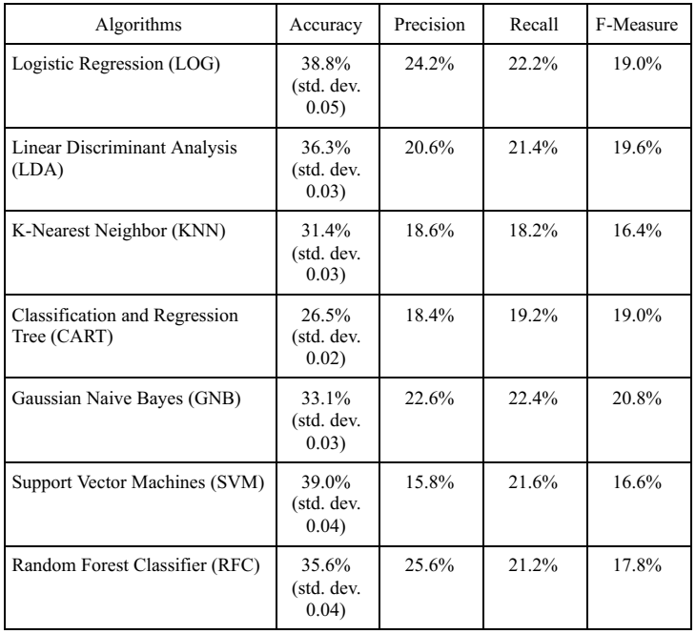
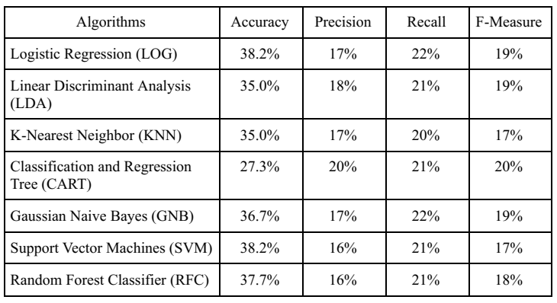
21
Multiclass Classification into 6 Levels of CF
Highest Holdout Method Accuracy
Logistic Regression and Support Vector Machines
Highest CV Accuracy
Support Vector Machines
Introduction | Literature Review | Methodology | Results & Discussion | Conclusion | References

Slide 25
22
Multiclass Classification into 6 Levels of CF
While the accuracy scores were higher than the probability of classifying a sample into one out of the 6 classes (1/6 = 16.67%), the accuracy scores achieved were less than satisfactory
Looking into the distribution of class samples, there is a severe imbalance in class distribution
ANALYSING CLASS SIZES
Frail: 7
Frail + MCI: 76
MCI: 133
Prefrail + MCI: 231
Prefrail: 221
Robust: 339
Introduction | Literature Review | Methodology | Results & Discussion | Conclusion | References

Slide 26
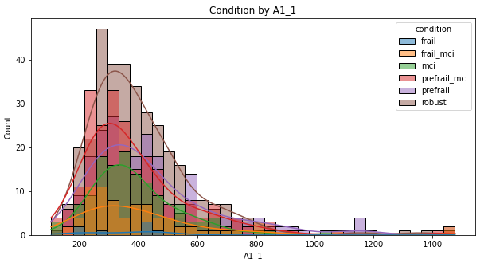
23
Multiclass Classification into 6 Levels of CF
To analyse the classification power of the features, a histogram plot is produced for a select number of features. The plot represents the distribution of values for each feature according to class membership
Feature values overlap greatly between classes
Severe overlapping makes it difficult for classification algorithms to differentiate samples between classes
Introduction | Literature Review | Methodology | Results & Discussion | Conclusion | References

Slide 27
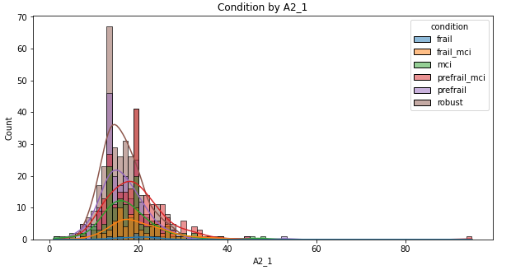
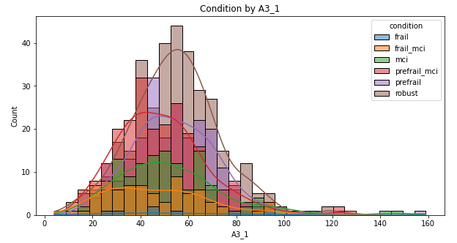
24
Multiclass Classification into 6 Levels of CF
Introduction | Literature Review | Methodology | Results & Discussion | Conclusion | References

Slide 28
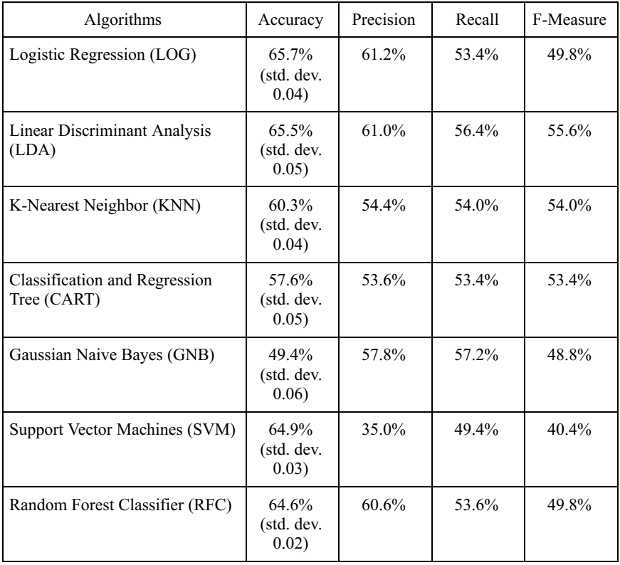
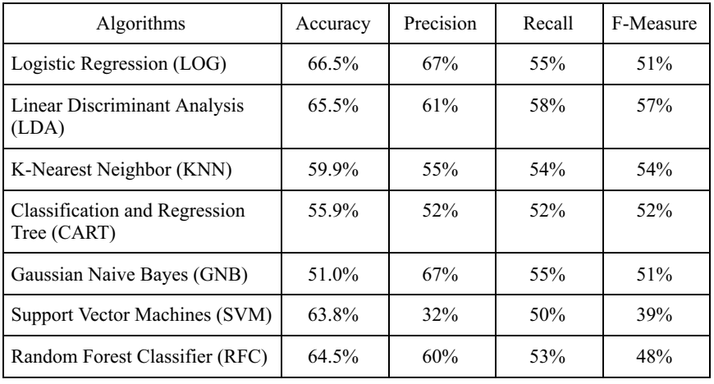
25
Binary Classification of Robust and Non-Robust
Highest Holdout Method and CV Accuracy
Logistic Regression
Introduction | Literature Review | Methodology | Results & Discussion | Conclusion | References

Slide 29
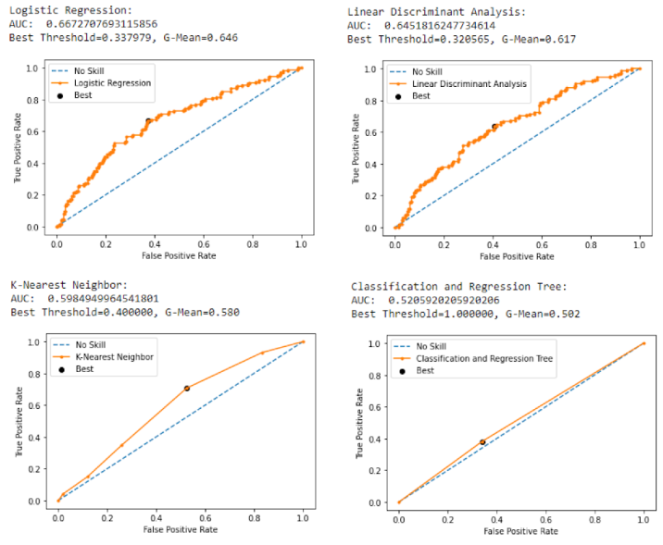
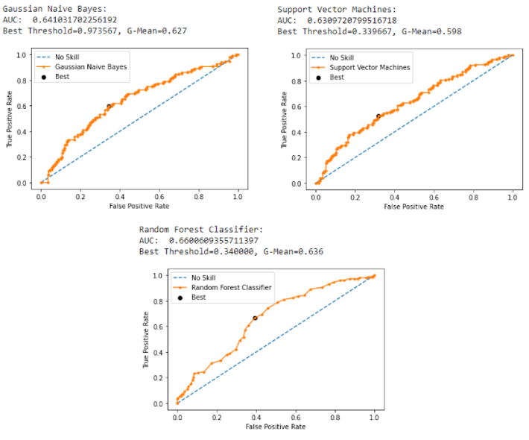
26
Binary Classification of Robust and Non-Robust
Introduction | Literature Review | Methodology | Results & Discussion | Conclusion | References

Slide 30
27
Binary Classification of Robust and Non-Robust
Grouping of classes to allow binary classification produces a better model accuracy
However, the classification of patients into Robust and Non-Robust does not prove to be useful
This classification task merely distinguishes healthy individuals from non-healthy individuals, with no indication of frailty or MCI in the classification. This task also does not clearly achieve the objectives of the research, which is to classify CF in patients
Introduction | Literature Review | Methodology | Results & Discussion | Conclusion | References

Slide 31
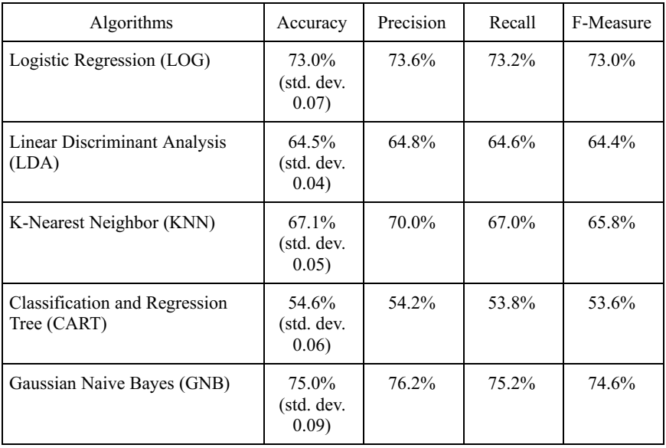
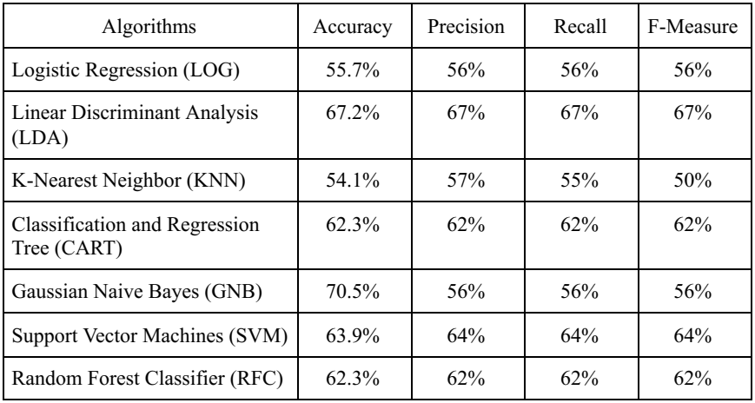
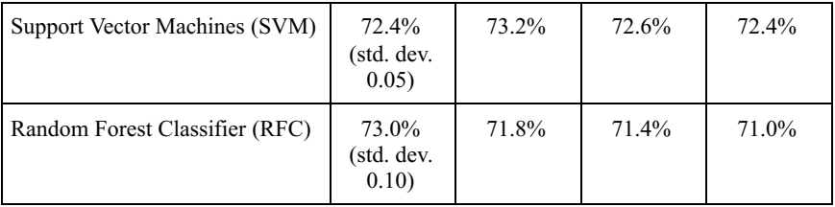
28
Binary Classification of Robust and Frail with MCI (76 Samples)
Highest Holdout Method and CV Accuracy
Gaussian Naïve Bayes
Introduction | Literature Review | Methodology | Results & Discussion | Conclusion | References

Slide 32
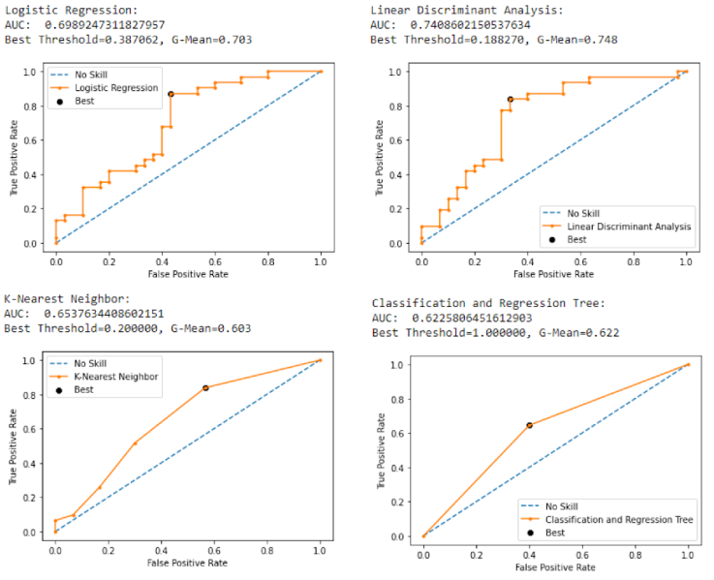
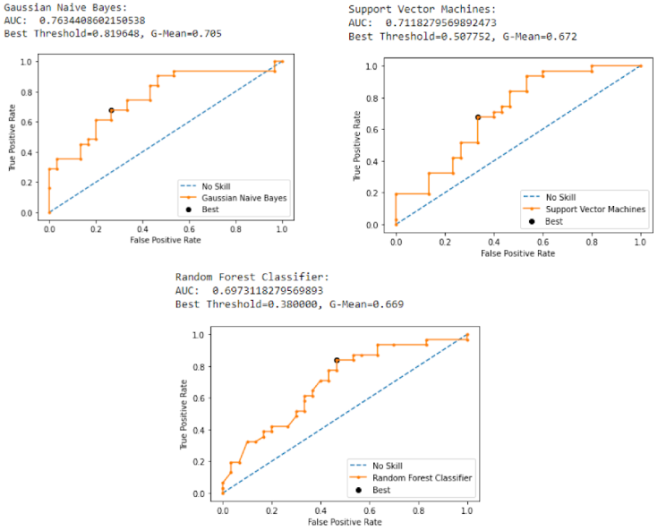
29
Binary Classification of Robust and Frail with MCI (76 Samples)
Introduction | Literature Review | Methodology | Results & Discussion | Conclusion | References

Slide 33
30
Binary Classification of Robust and Frail with MCI (76 Samples)
Model accuracy further improved compared to Robust vs Non-Robust
Better at achieving the research objectives (patients with Frailty and MCI can be distinguished from healthy individuals)
There is concern with regards to sample size for model training. Higher accuracy scores could be attributed to small test dataset size, rather than good model performance
Synthetic Minority Oversampling Technique (SMOTE) is used to oversample dataset to obtain bigger sample size
Introduction | Literature Review | Methodology | Results & Discussion | Conclusion | References

Slide 34
31
Exploring SMOTE and Various Class Distributions
Quick analysis was done to understand the relationship between varying SMOTE amounts and the model accuracy and AUC
Model training and performance evaluation was done iteratively by varying the undersampling of the majority class (Robust)
After undersampling, the minority class (Frail with MCI) is SMOTE-ed to match the class size of the majority class
Major
Major
Major
Undersampled
Minor
300
224
Before SMOTE
Minor
Minor
…
76
76
77
76
76
SMOTE-ed samples
Introduction | Literature Review | Methodology | Results & Discussion | Conclusion | References

Slide 35
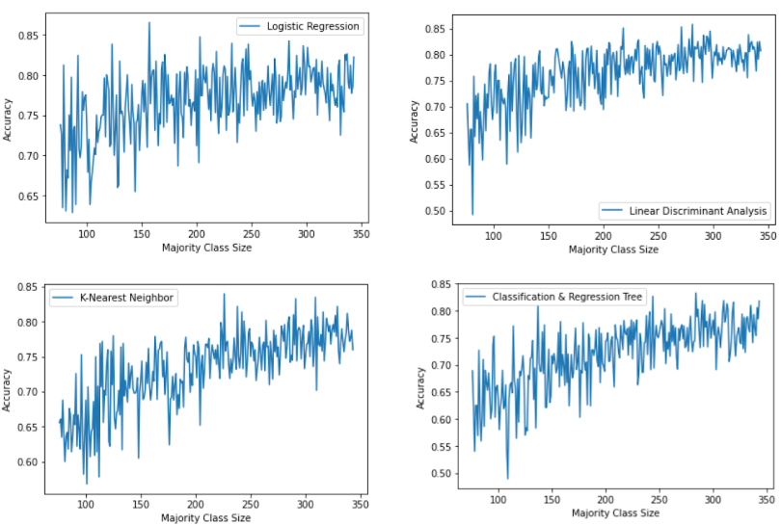
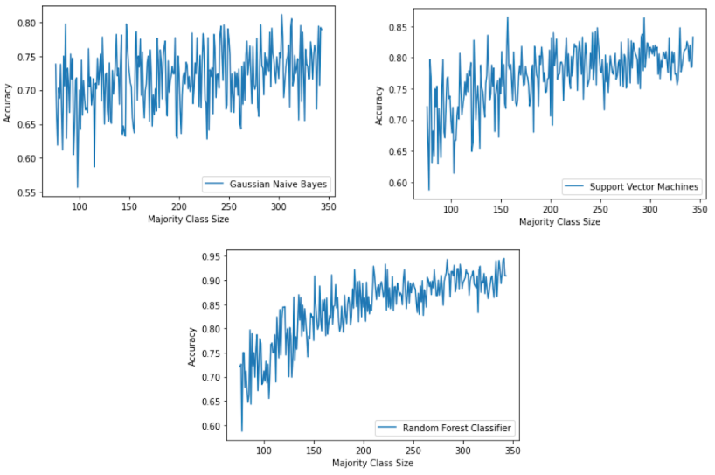
32
Exploring SMOTE and Various Class Distributions
Plots of Accuracy against Majority Class Size
Introduction | Literature Review | Methodology | Results & Discussion | Conclusion | References

Slide 36
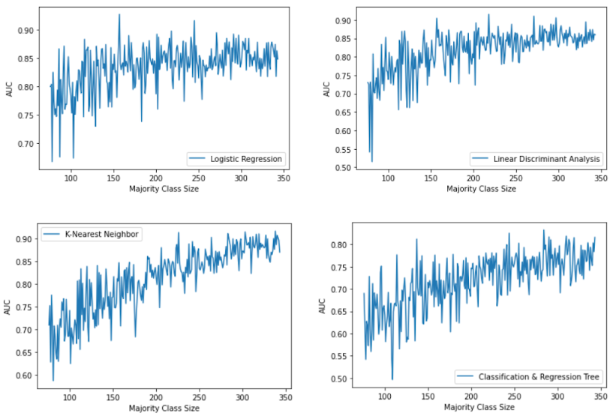
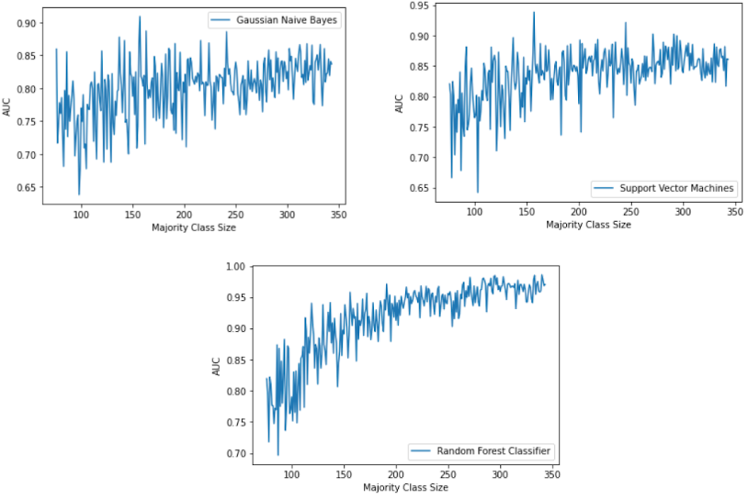
33
Exploring SMOTE and Various Class Distributions
Plots of AUC against Majority Class Size
Introduction | Literature Review | Methodology | Results & Discussion | Conclusion | References

Slide 37
34
Exploring SMOTE and Various Class Distributions
Fluctuating behaviour of both model accuracy and AUC is associated with the stochastic nature of the classification algorithms or evaluation procedures
Fluctuation reduces (graph becomes more stable) as the majority class size increases
As the majority class size increases, both the accuracy and AUC increase
Due to an increase in the number of samples being SMOTE-ed
SMOTE-ed samples are much more predictable for the classification models. This predictability contributes to the increase of model accuracy and AUC.
SMOTE improves model performance scores, but dataset
should not be SMOTE-ed too much
Introduction | Literature Review | Methodology | Results & Discussion | Conclusion | References

Slide 38
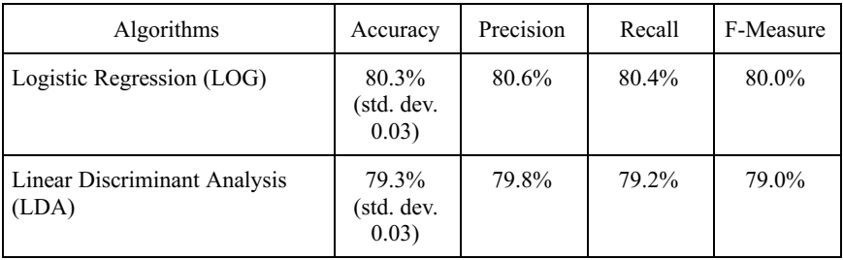

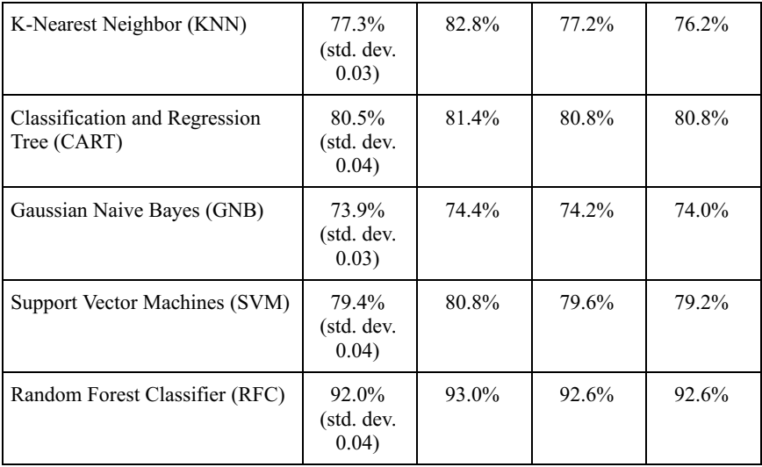
35
Binary Classification of Robust and Frail with MCI (343 Samples)
Highest Holdout Method and CV Accuracy
Random Forest Classifier
Introduction | Literature Review | Methodology | Results & Discussion | Conclusion | References

Slide 39
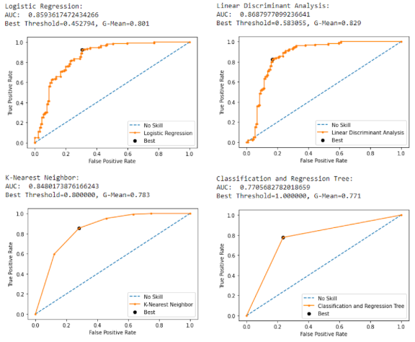
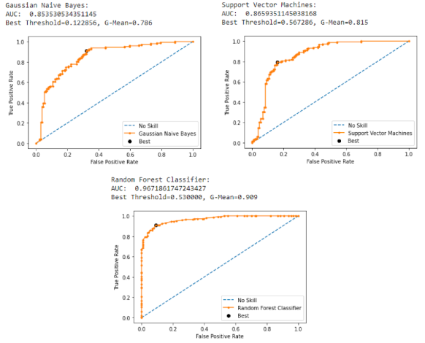
36
Binary Classification of Robust and Frail with MCI (343 Samples)
Introduction | Literature Review | Methodology | Results & Discussion | Conclusion | References

Slide 40
37
Binary Classification of Robust and Frail with MCI (343 Samples)
The model accuracy was the highest among all the classification tasks and class distributions
As described previously, the high performance in evaluation scores are associated with the predictability of SMOTE-ed samples
While the model performance scores show good results, it is not a good option to apply the models from this approach for the disease classification.
Introduction | Literature Review | Methodology | Results & Discussion | Conclusion | References

Slide 41
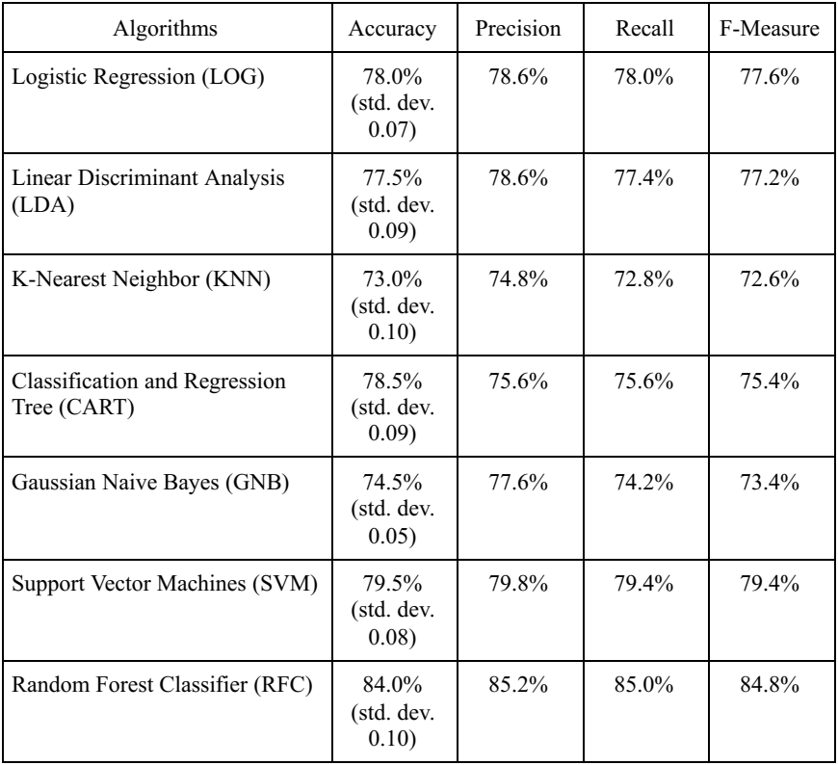
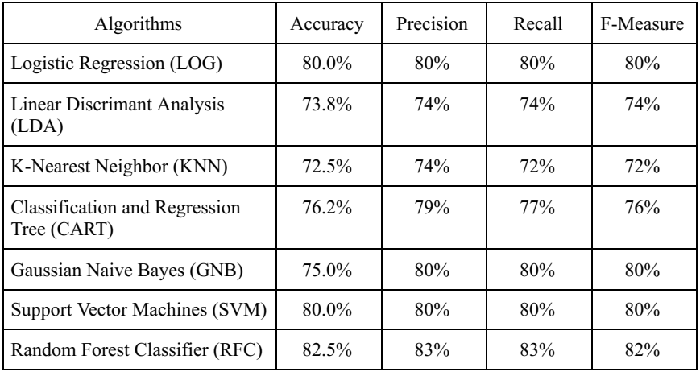
38
Binary Classification of Robust and Frail with MCI (100 Samples)
Highest Holdout Method and CV Accuracy
Random Forest Classifier
Introduction | Literature Review | Methodology | Results & Discussion | Conclusion | References

Slide 42
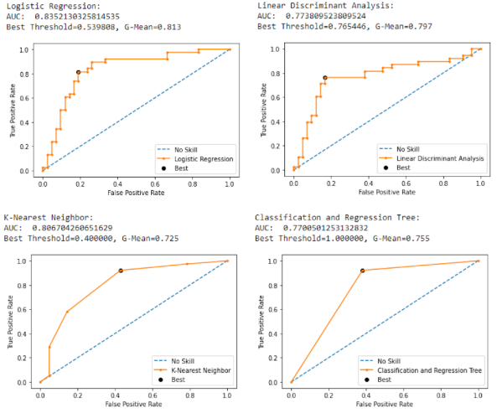
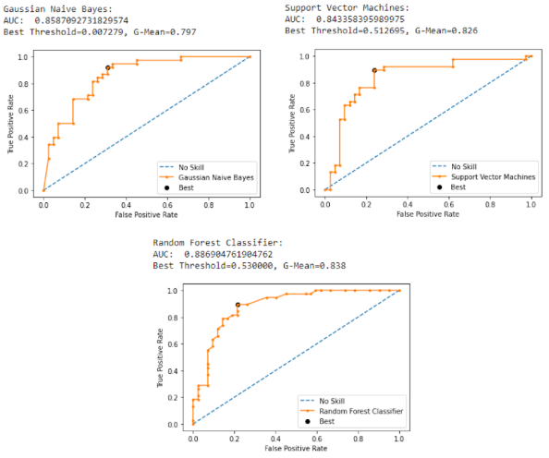
39
Binary Classification of Robust and Frail with MCI (100 Samples)
Introduction | Literature Review | Methodology | Results & Discussion | Conclusion | References

Slide 43
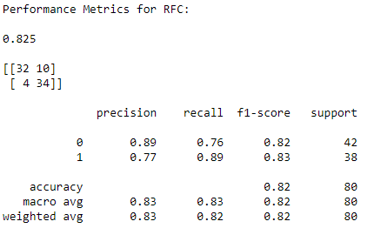
40
Binary Classification of Robust and Frail with MCI (100 Samples)
Model accuracy not as high as second distribution (343 samples), due to less SMOTE-ed samples and subsequently less predictability
By conducting SMOTE for a small number of samples, there is now a sufficient number of samples for the dataset (200 samples), while keeping the reliability of the model in control
Introduction | Literature Review | Methodology | Results & Discussion | Conclusion | References

Slide 44
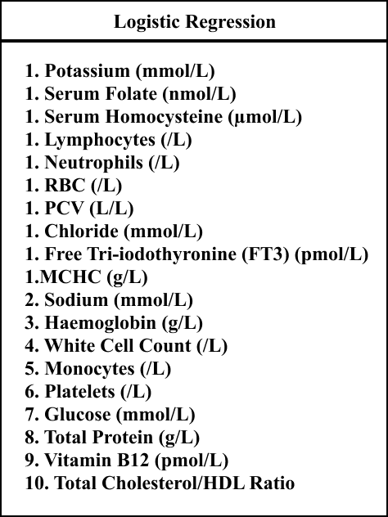
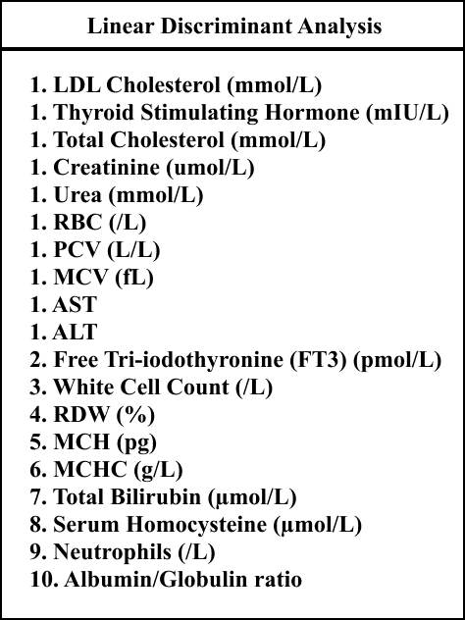
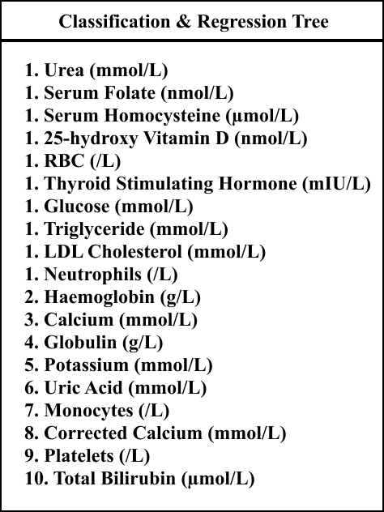
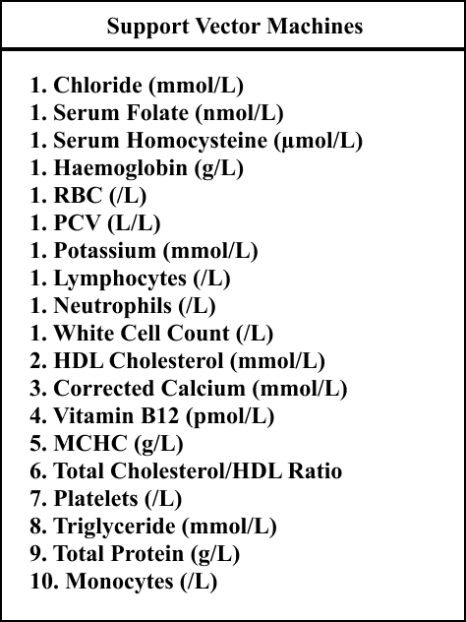
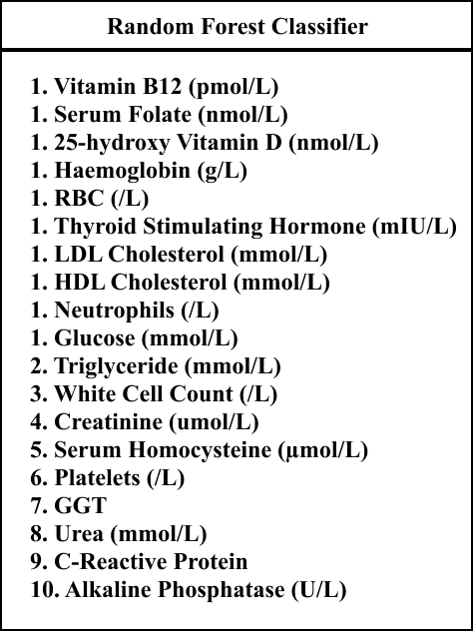
41
Significant Blood Biomarkers in CF (6 classes)
Frequently returned features (features that were returned by at least 4 algorithms):
Serum Homocysteine, Neutrophils, RBC, Serum Folate, Haemoglobin, White Cell Count, Platelets
Introduction | Literature Review | Methodology | Results & Discussion | Conclusion | References

Slide 45
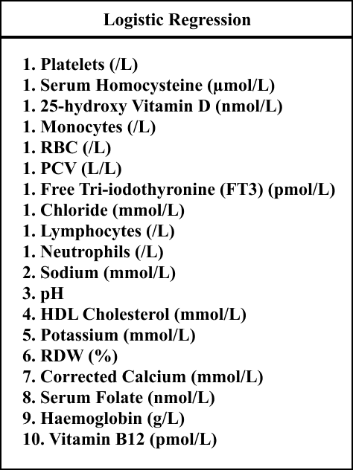
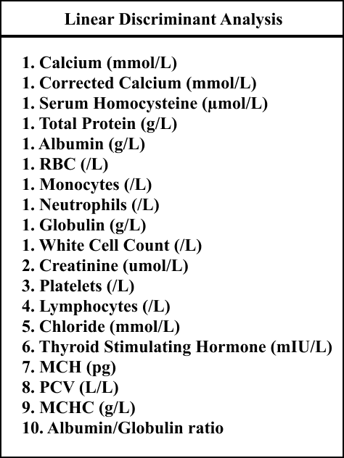
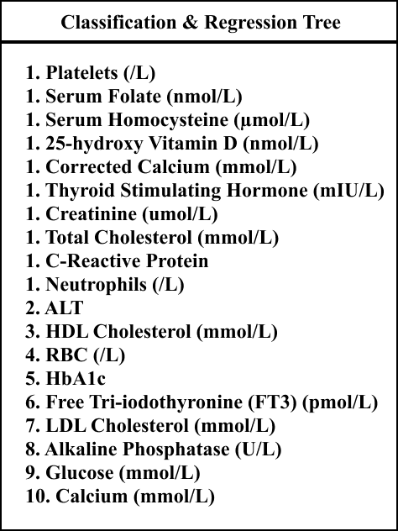
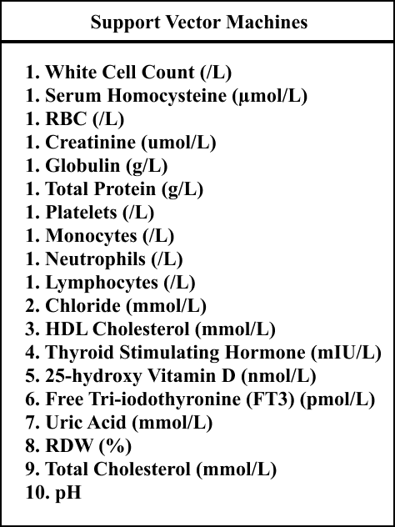
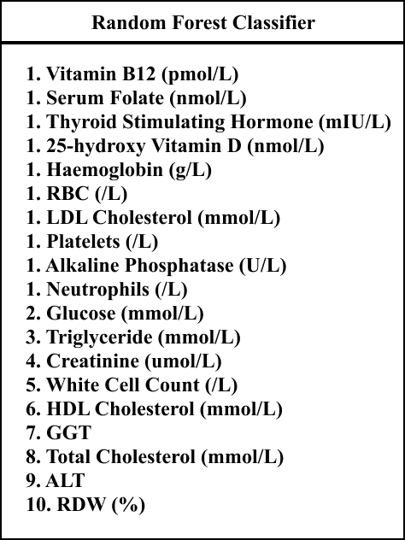
42
Significant Blood Biomarkers in CF (Robust and Non-Robust)
Frequently returned features:
Platelets, RBC, Neutrophils, Serum Homocysteine, 25-hydroxy Vitamin D, HDL Cholesterol, Creatinine, Thyroid Stimulating Hormone
Introduction | Literature Review | Methodology | Results & Discussion | Conclusion | References

Slide 46



43
Significant Blood Biomarkers in CF (Robust and Frail with MCI – 76 Samples)
Frequently returned features:
Total Bilirubin, Serum Homocysteine, RBC, MCV, Thyroid Stimulating Hormone, PCV, Lymphocytes, Serum Folate, Glucose, Haemoglobin, Albumin/Globulin ratio
Introduction | Literature Review | Methodology | Results & Discussion | Conclusion | References

Slide 47



44
Significant Blood Biomarkers in CF (Robust and Frail with MCI – 343 Samples)
Frequently returned features:
Serum Homocysteine, C-Reactive Protein, RBC, PCV, ALT, Sodium, Serum Folate, 25-hydroxy Vitamin D, Potassium, Creatinine, Neutrophils
Introduction | Literature Review | Methodology | Results & Discussion | Conclusion | References

Slide 48



45
Significant Blood Biomarkers in CF (Robust and Frail with MCI – 100 Samples)
Frequently returned features:
Serum Folate, PCV, Chloride, Glucose, C-Reactive Protein, Serum Homocysteine, pH, ALT, RBC, Creatinine, Vitamin B12, LDL Cholesterol, White Cell Count
Introduction | Literature Review | Methodology | Results & Discussion | Conclusion | References

Slide 49
46
Significant Blood Biomarkers in CF
When we compare the Significant Blood Biomarkers from all classification groups (1 multiclass and 4 binary classification), we find these biomarkers to be frequently appearing:
Serum Homocysteine – 5 classification groups
RBC – 5 classification groups
Serum Folate – 4 classification groups
There is a strong indication that these 3 biomarkers are associated with Cognitive Frailty in Elderly People
This has been further validated with medical researchers whereby serums have a strong correlation with CF
Introduction | Literature Review | Methodology | Results & Discussion | Conclusion | References

Slide 50
47
Conclusion
Cognitive Frailty (CF) is a prevalent condition affecting older adults, which requires early and rapid medical intervention by medical professionals
The existence of a classification model for Cognitive Frailty (CF) helps in identifying the condition among older adults at its presymptomatic stages in a short duration of time
By implementing a classification model using biomarkers such as blood parameters, it is possible to identify Cognitive Frailty using tissue and serum collection from patients, rather than the existing clinical measurements
Class imbalance from the selected dataset contributed greatly to the poor accuracy of multiclass classification. Future efforts on enabling a high performing classification model should ensure a well-balanced dataset is used.
Introduction | Literature Review | Methodology | Results & Discussion | Conclusion | References

Slide 51
48
References
[1] L. P. Fried et al., “Frailty in older adults: evidence for a phenotype,” J. Gerontol. A Biol. Sci. Med. Sci., vol. 56, no. 3, pp. M146-56, 2001.
[2] Z. S. Nasreddine, N. A. Phillips, V. R. Bã©Dirian, S. Charbonneau, V. Whitehead, I. Collin, J. L. Cummings, and H. Chertkow, “The Montreal Cognitive Assessment, MoCA: A Brief Screening Tool For Mild Cognitive Impairment,” Journal of the American Geriatrics Society, vol. 53, no. 4, pp. 695–699, 2005.
[3] Buchman, A. and Bennett, D., 2013. Cognitive frailty. The journal of nutrition, health & aging, 17(9), pp.738-739.
[4] H. Shimada, H. Makizako, T. Doi, K. Tsutsumimoto, S. Lee, and T. Suzuki, “P3-371: Impact of Cognitive Frailty on Daily Activities in Older Persons,” Alzheimers & Dementia, vol. 12, 2016.
[5] C. Cano, R. Samper-Ternent, S. A. Snih, K. Markides, and K. J. Ottenbacher, “Frailty and cognitive impairment as predictors of mortality in older Mexican Americans,” The journal of nutrition, health & aging, vol. 16, no. 2, pp. 142–147, 2011.
[6] N. Malek Rivan et al., "Cognitive frailty among Malaysian older adults: baseline findings from the LRGS TUA cohort study", Clinical Interventions in Aging, vol. 14, pp. 1343-1352, 2019. Available: 10.2147/cia.s211027 [Accessed 6 February 2021].
[7] H. Kim, P. A. Higgins, D. H. Canaday, C. J. Burant, and T. R. Hornick, “Frailty assessment in the geriatric outpatient clinic,” Geriatrics & Gerontology International, vol. 14, no. 1, pp. 78–83, 2013.
Introduction | Literature Review | Methodology | Results & Discussion | Conclusion | References

Slide 52
49
References
[8] F. Babič, L. Trtica Majnarić, S. Bekić, and A. Holzinger, “Machine learning for family doctors: A case of cluster analysis for studying aging associated comorbidities and frailty,” in Lecture Notes in Computer Science, Cham: Springer International Publishing, 2019, pp. 178–194, 2019.
[9] A. P. Hassler, E. Menasalvas, F. J. García-García, L. Rodríguez-Mañas, and A. Holzinger, “Importance of medical data preprocessing in predictive modeling and risk factor discovery for the frailty syndrome,” BMC Med. Inform. Decis. Mak., vol. 19, no. 1, p. 33, 2019.
[10] M. S. Crane, “Classification and prediction of clinical Alzheimer’s diagnosis based on plasma signalling proteins,” Ann. Clin. Biochem., vol. 45, no. 2, pp. 231–232, 2008.
Introduction | Literature Review | Methodology | Results & Discussion | Conclusion | References

Slide 53


49
Achievements
IEEE BHI-BSN 2021 (Accepted and Presented)
iCAN 2021 (Canada)

Slide 54
Thank You

